Slide 1



Pipelines for Women into the Trades

Slide 2
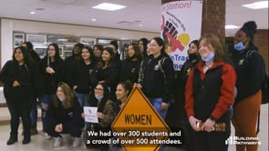
Our Consortium
Building Pathways
Policy Group on Tradeswomen’s Issues (PGTI)
Massachusetts Girls in Trades (MA GIT)
Recruitment, retention and advancement of diverse workers in the union building trades, including women, people of color, and other under-served groups. https://vimeo

Slide 3
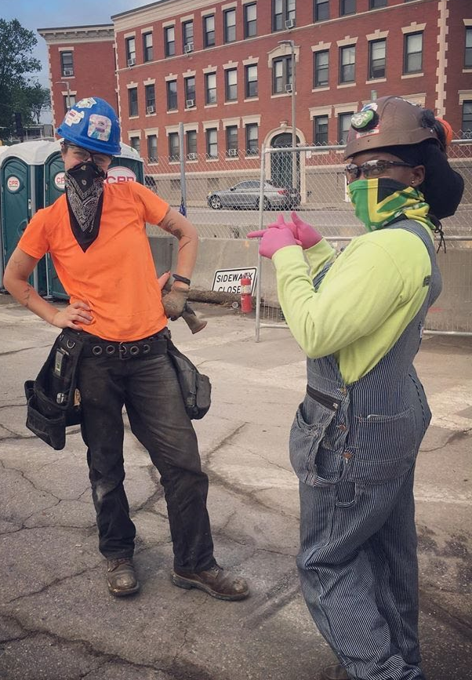
Launching a Career in the Union Building Trades – Apprenticeship 101
3-5 years of training on the job and in a classroom/shop in the tools and skills of your trade
Start working at $19-25+/hour with scheduled raises of
5 – 10%
Training on the job with an experienced partner
Become a journey worker at $60,000/year and up
It’s an education like going to college BUT NO DEBT!

Slide 4
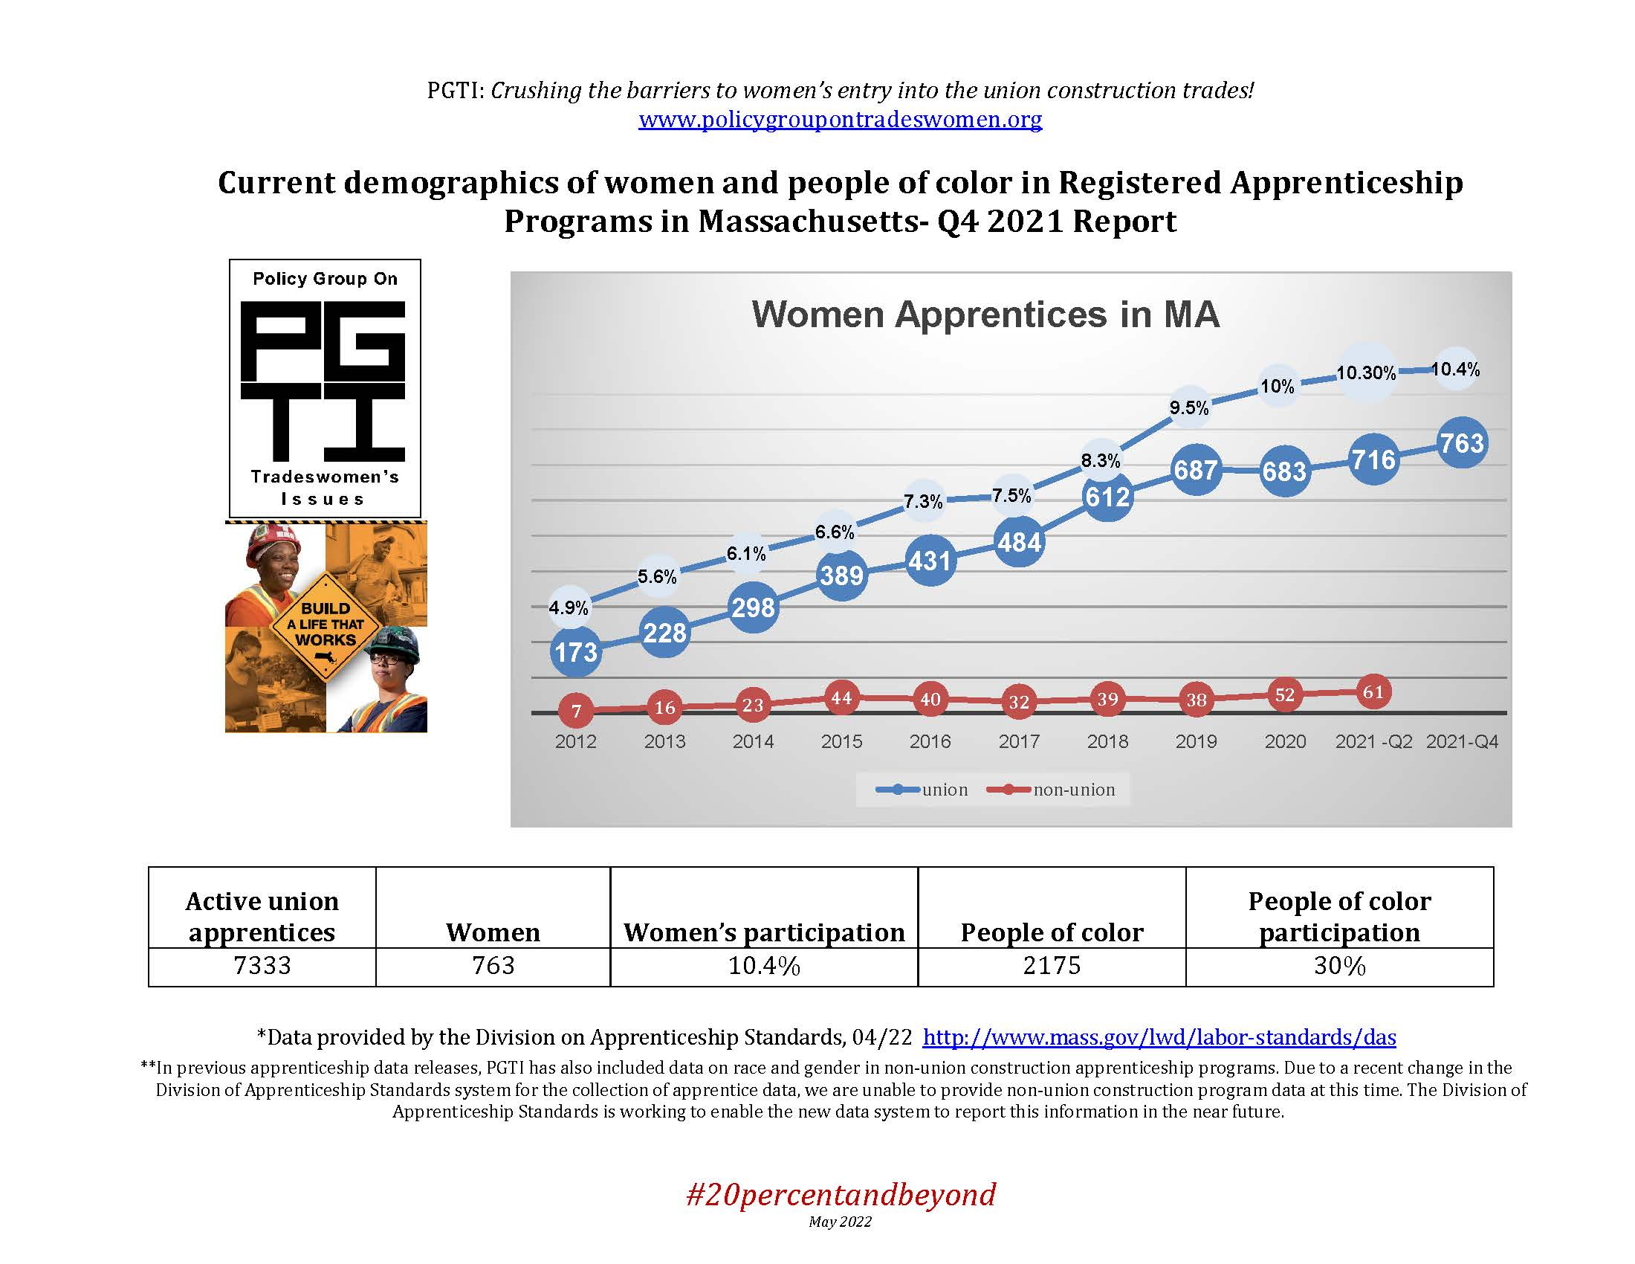

Slide 5
How We Got Here
Integrated supply and demand strategy:
  Supply: Create a Pipeline of diverse workers for entry into apprenticeships
  Demand: Promote policies and practices that create employment opportunities for diverse workers and keep them working and learning
Notes:
Supply:
Pre-Apprenticeship training – Building Pathways
Outreach to Diverse Groups, especially women – Build A Life That Works
Connecting high school students with the building trades – MA GIT
Demand:
Public:
State Strategy
2 state laws and an Executive Order that require contractors on state-funded or state-assisted projects to meet workforce participation goals of 6.9% women and 15.3% minorities
Municipalities - Boston Jobs Residency Policy – 51% residents; 40% POC and 12% women – both private and public
Private:
Workforce participation goals set by private owners/developers, often in a Project Labor Agreement

Slide 6
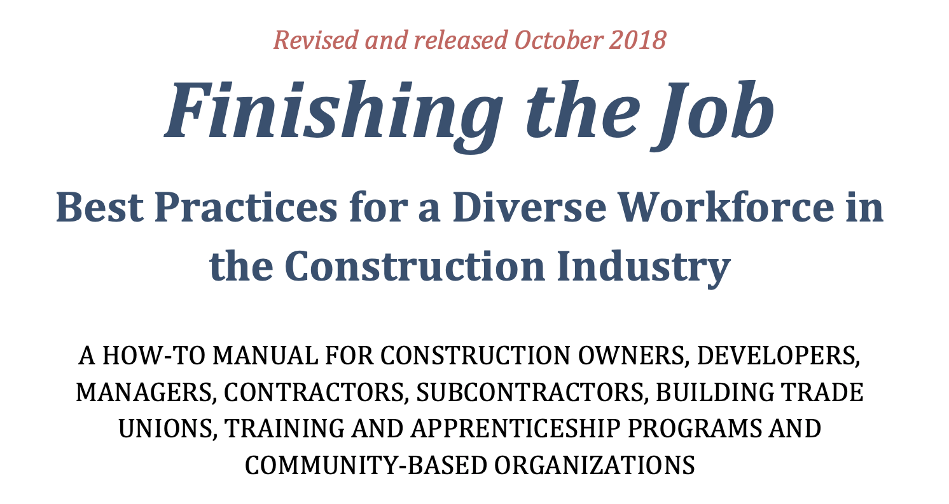
Policy Group on Tradeswomen’s Issues
An ongoing regional collaboration of construction industry stakeholders crushing the barriers to good jobs for women in the construction trades.
Meeting for the past 13 years.

Slide 7
PGTI Essential Best Practices
Set workforce participation goals – set high targets
Count and report - implement internal compliance infrastructure to monitor and adjust course
Access and Opportunity Committees – multi-stakeholder group led by GC/CM
  REVIEW: diversity compliance across the project and for every subcontractor, focusing on high impact, poor performers.
  CORRECTIVE ACTION: plans and other best practices to ensure the project meets or exceeds goals for a diverse workforce, including frequent meetings with non-compliant subcontractors.
  LEARNING COMMUNITY: members develop strong working relationships, recognize that they are in a unique learning environment and grow to share a commitment to making real change in an important industry
Diverse core crews

Slide 8


Boost Supply Pipeline to Apprenticeship
If you can see it, you can be it!
Outreach
Pre-Apprenticeships
Vocational High Schools
Build A Life That Works
Apprenticeship
Journey Worker

Slide 9
Pipeline 1 - Pre-Apprenticeship Training
Pipeline for low to moderate income women, people of color, and urban youth to enter family-sustaining careers in the trades
Prepare participants to enter a registered building trades apprenticeship program
Classroom and hands-on instruction, and field trips to apprenticeship training centers and active construction sites
Participants learn about all the trades and receive support in applying for an apprenticeship opportunity
Provide supportive services and career counseling

Slide 10
Pre-Apprenticeship Program Elements
    Outreach & recruitment
    Applicant intake & assessment
    Employability and Occupational Skills training
    Employment/apprenticeship placement
    Case management/Support Services
    Retention
    Industry engagement and community partnerships

Slide 11

Construction-hours child care now available!
Pilot program in Boston area working with licensed family child care providers to offer child care starting at 5 or 5:30am
Child care providers all accept childcare vouchers, their weekly rates vary
Scholarships for families without vouchers of $100/week for 6 months paid to provider for tuition discount
Notes:
So here are some of the nuts and bolts of the pilot program:

Slide 12
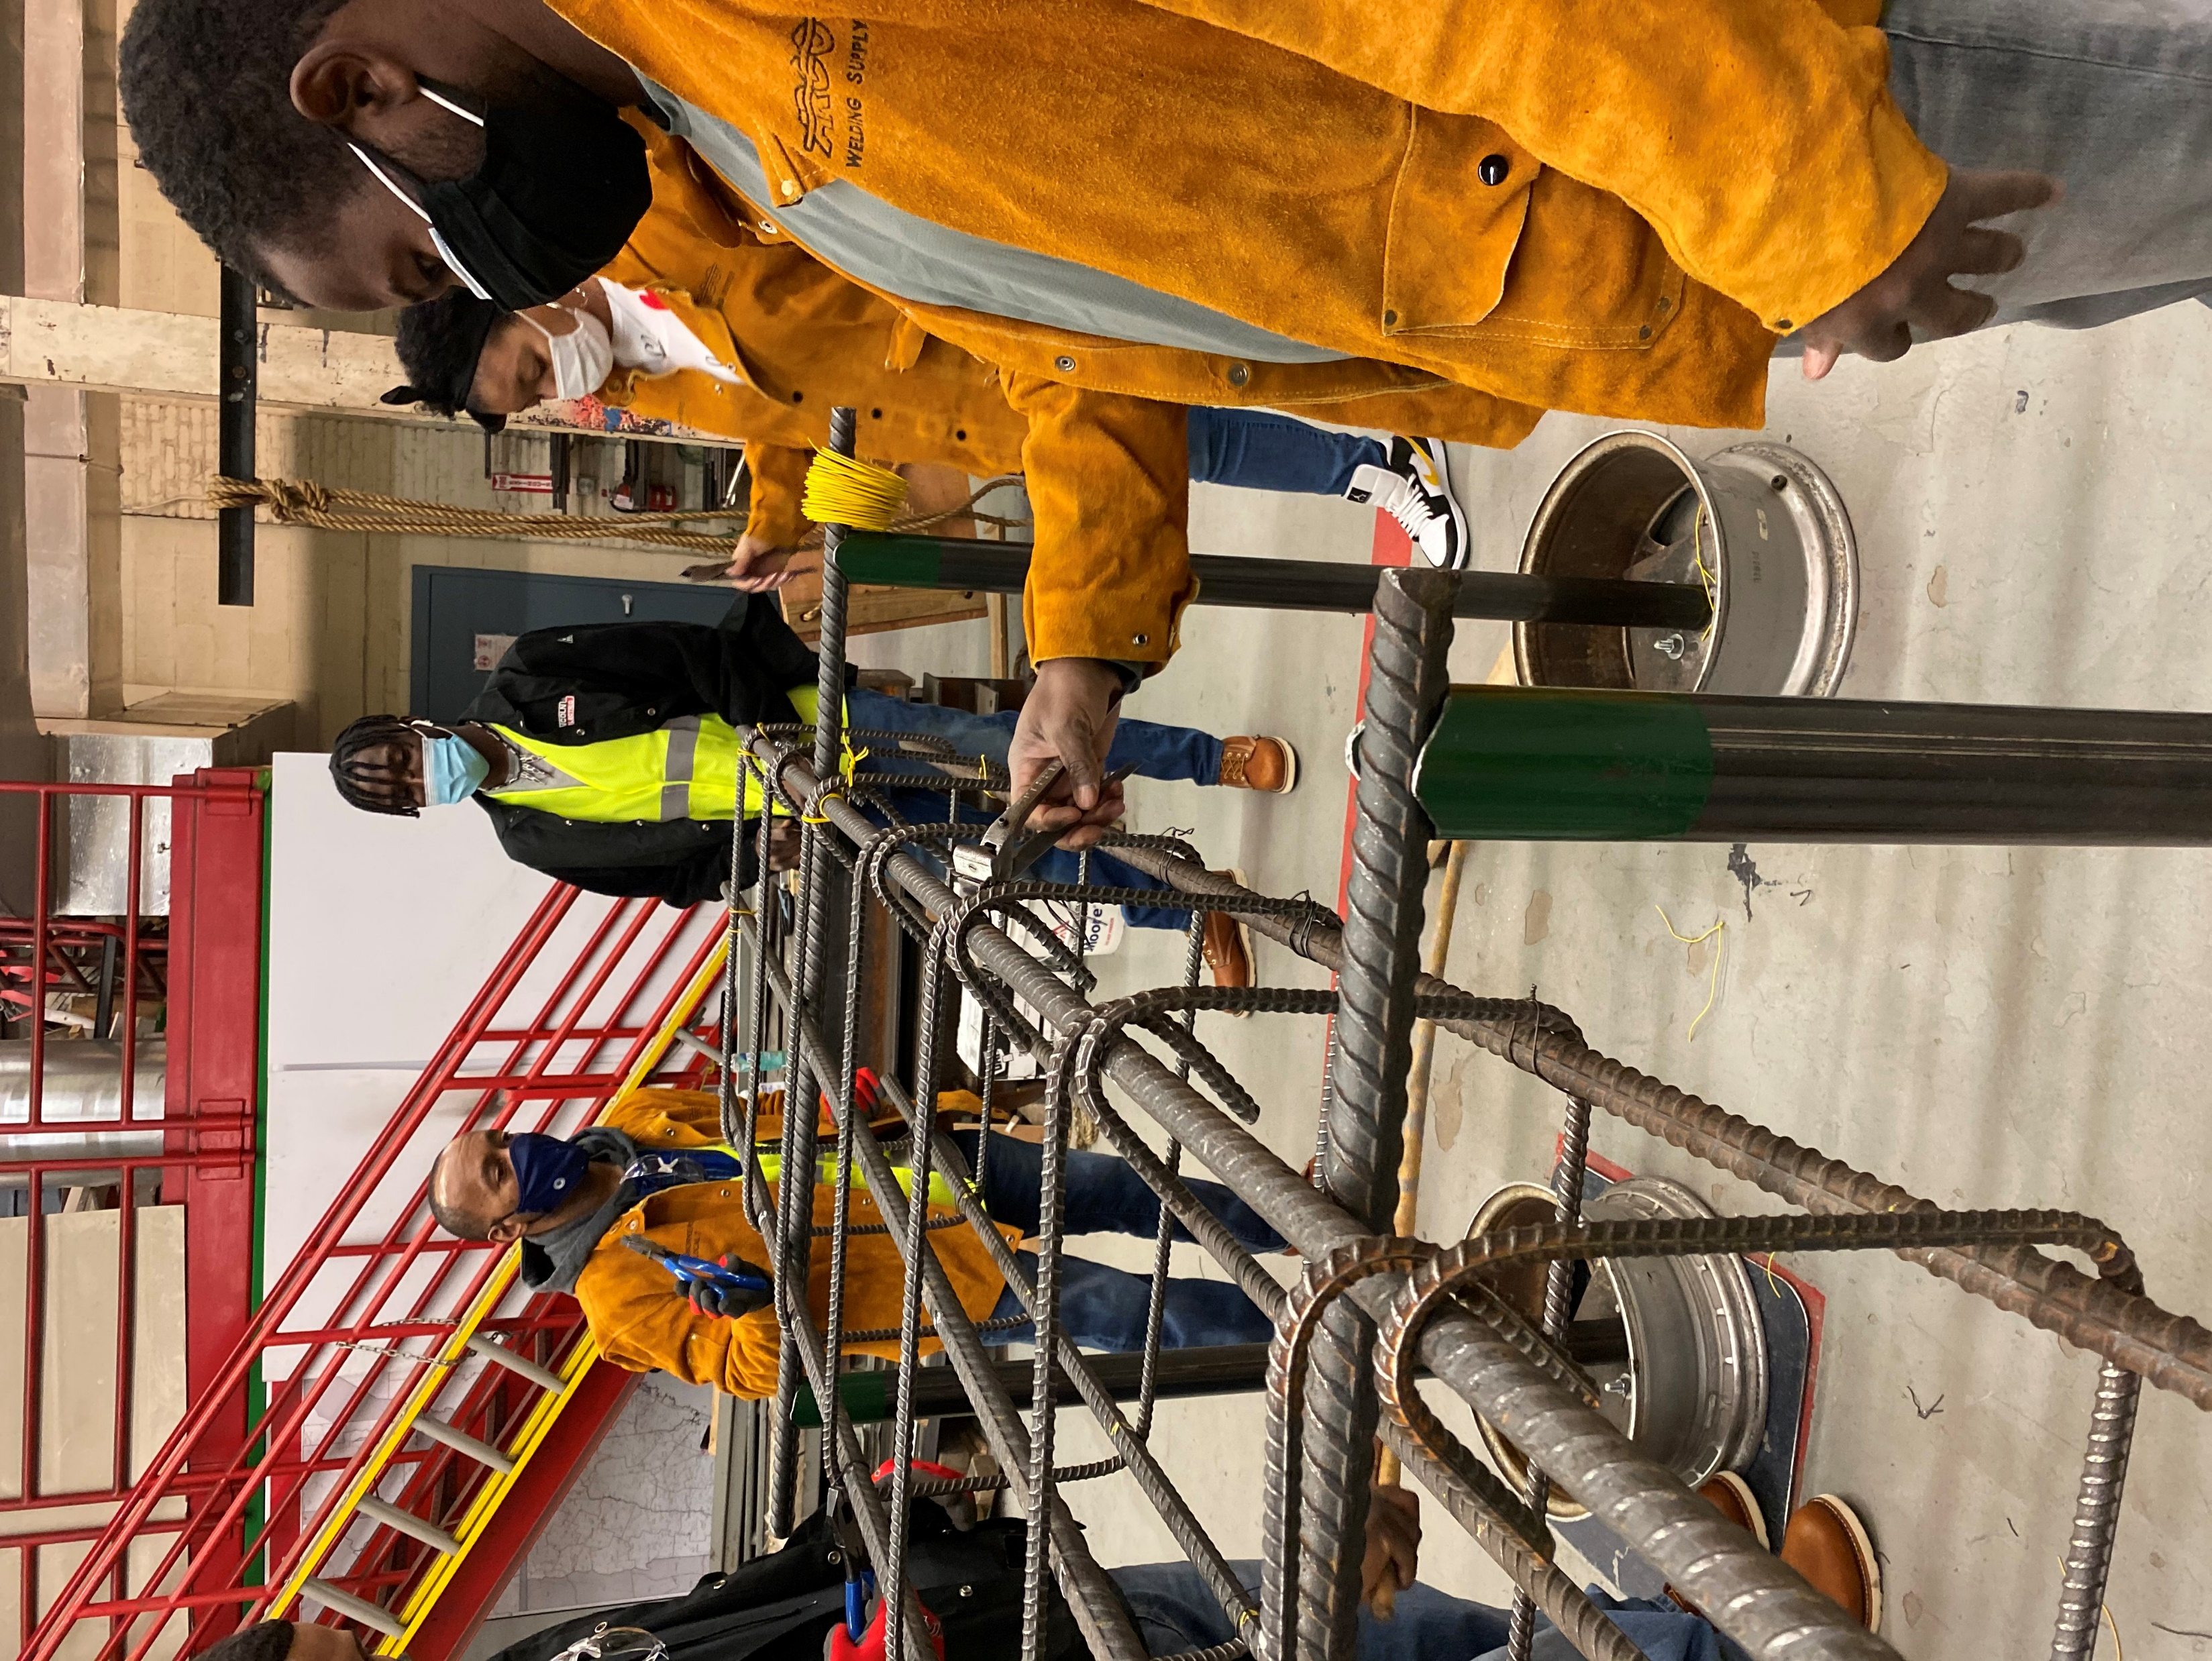
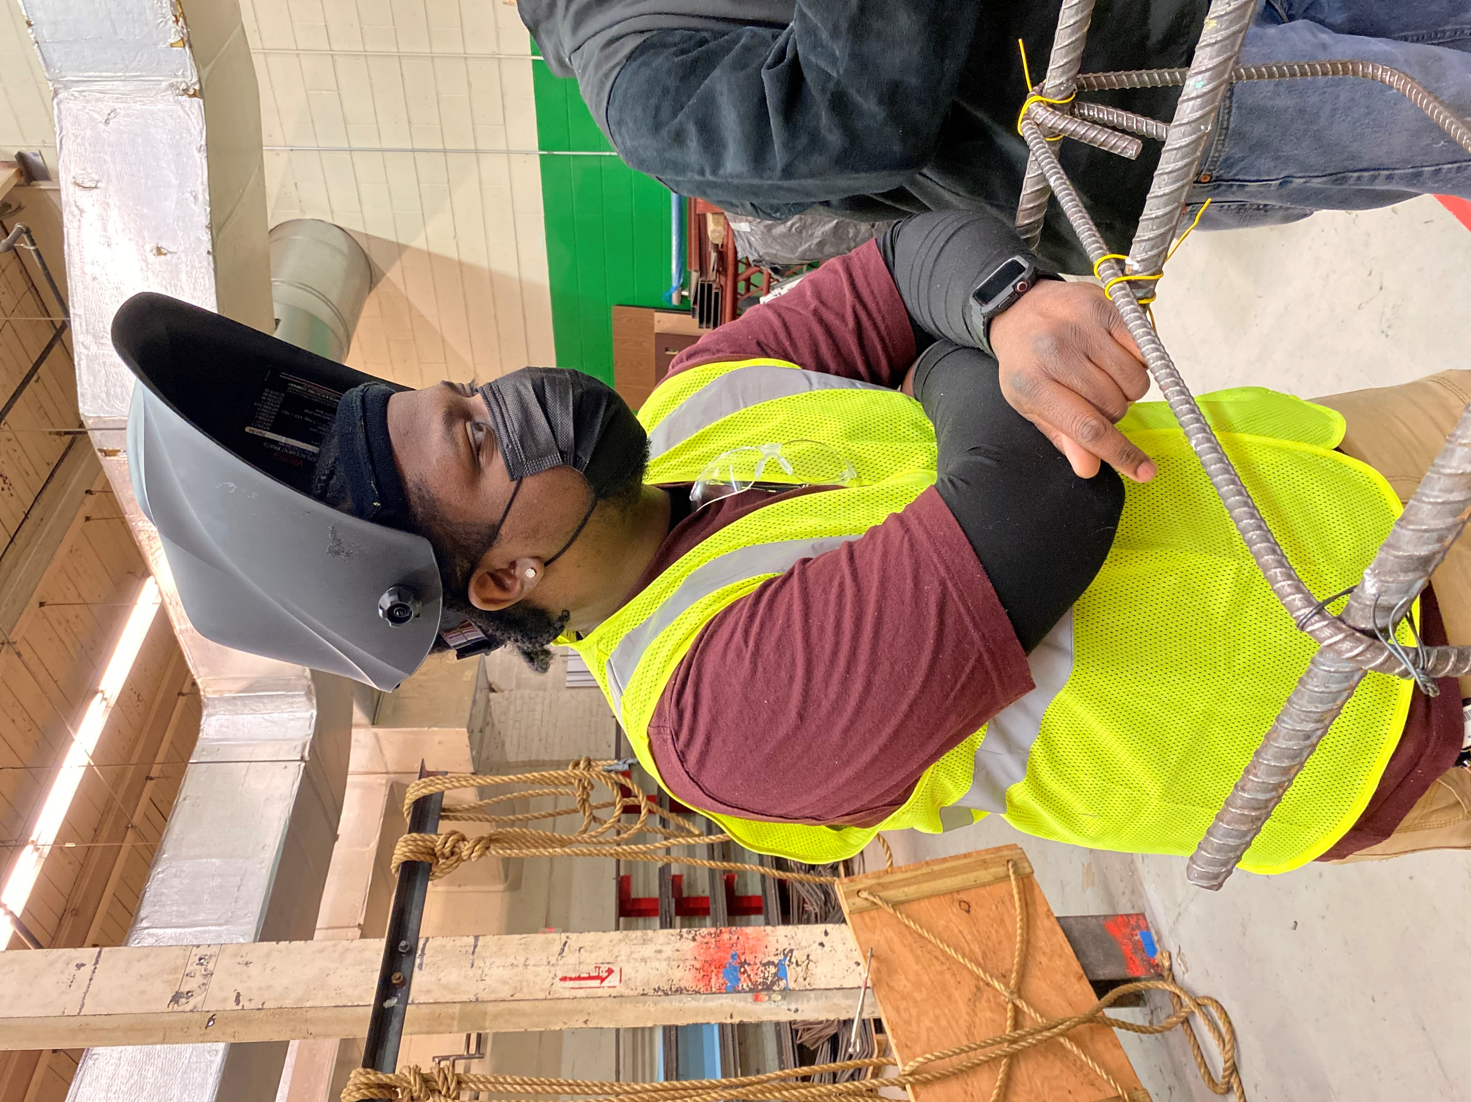
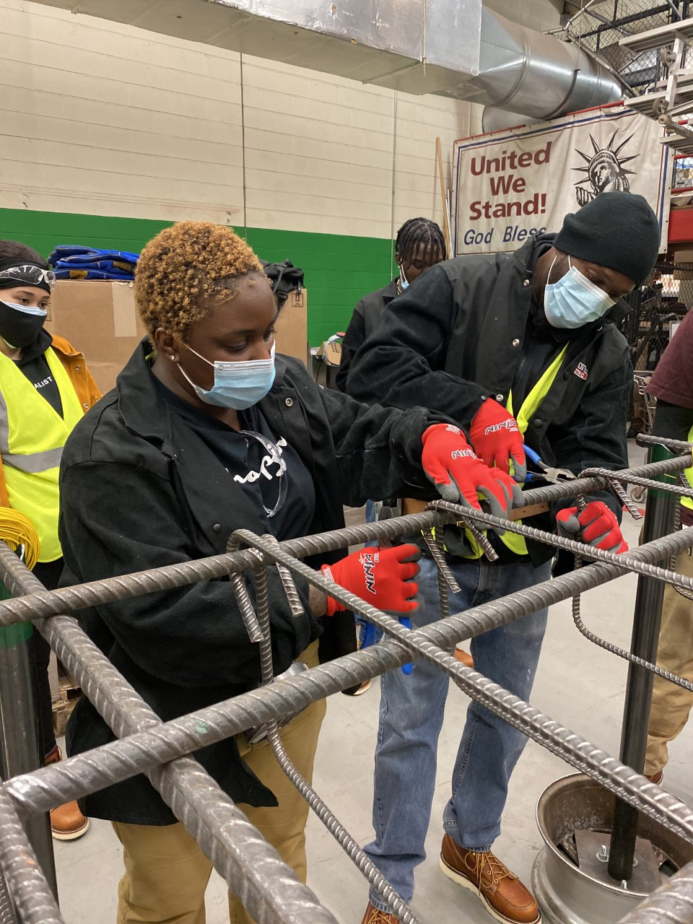
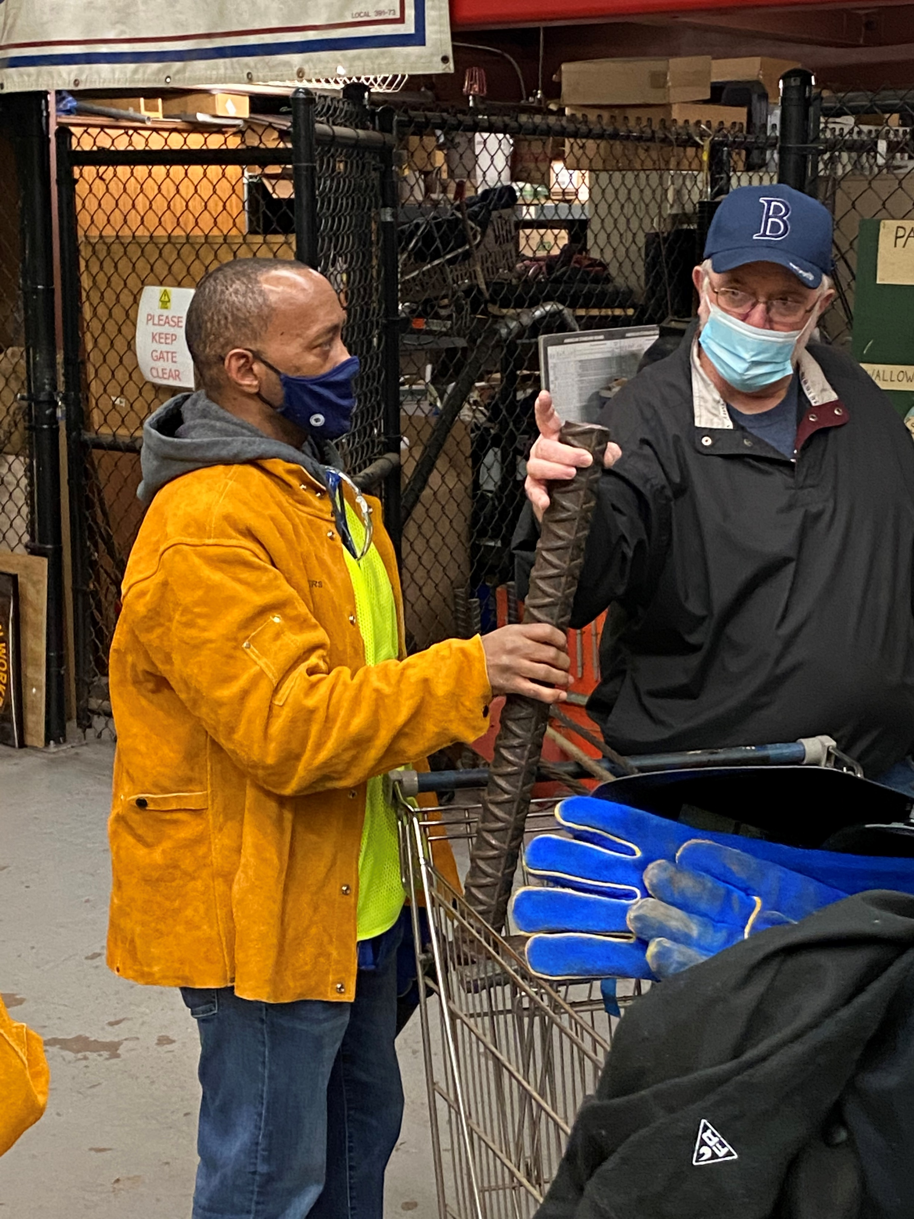
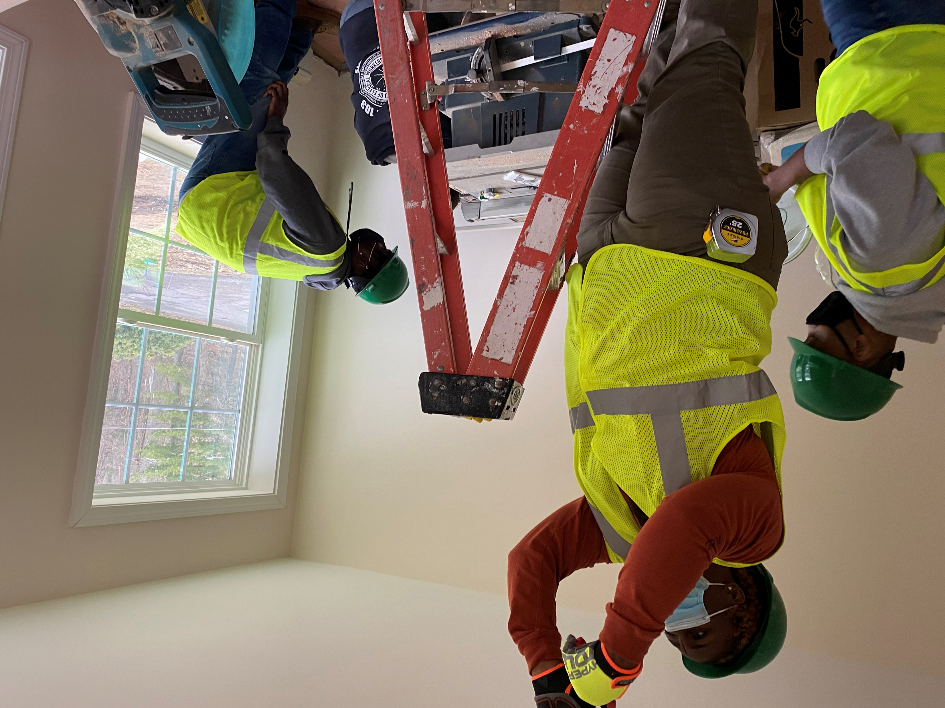
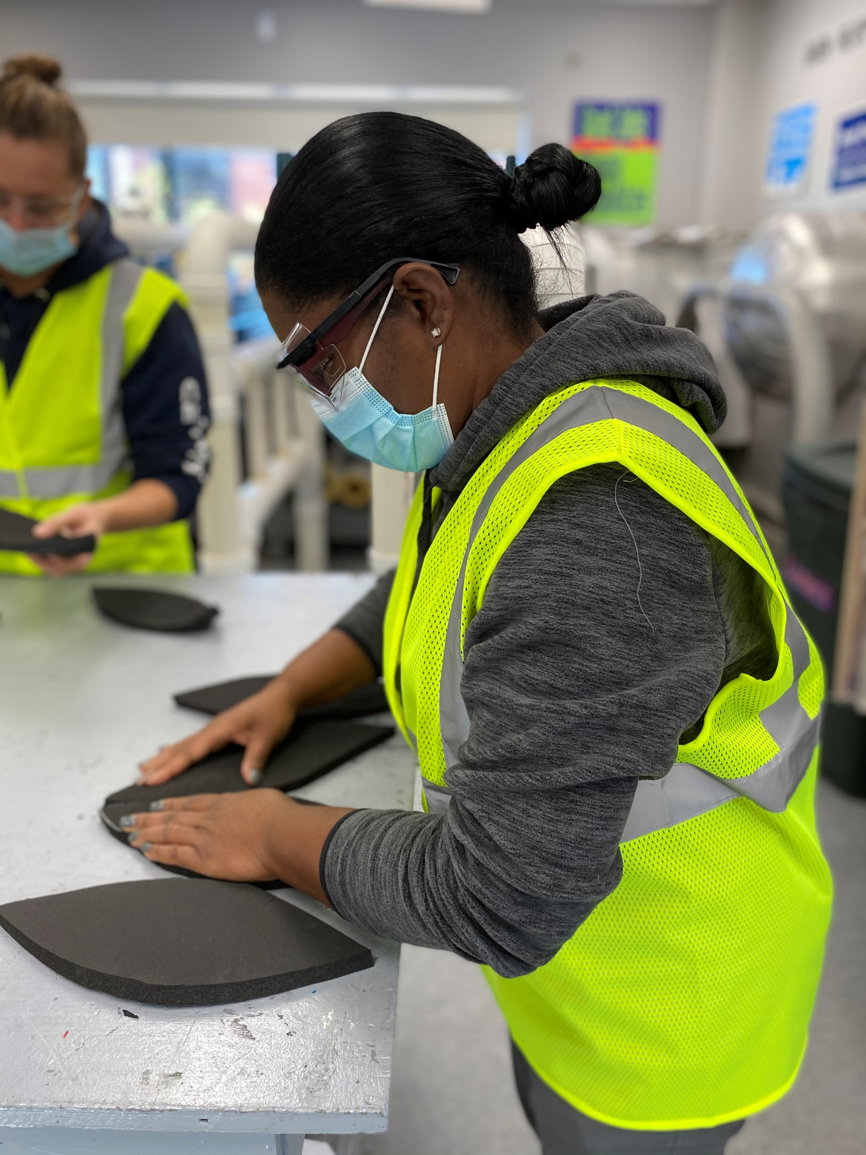

Slide 13

Pipeline 2 – Northeast Center for Tradeswomen’s Equity - Build A Life That Works
Education campaign to expose women to careers in the building trades
  Heighten the visibility of women in the trades – You Can Do It Too
  Connect women career seekers to tradeswomen
  Career navigation - GPS not Uber

Slide 14

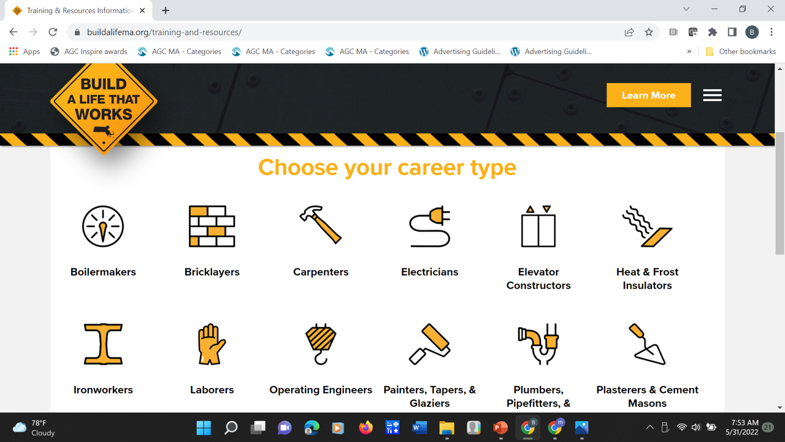
Build A Life That Works Website

Slide 15
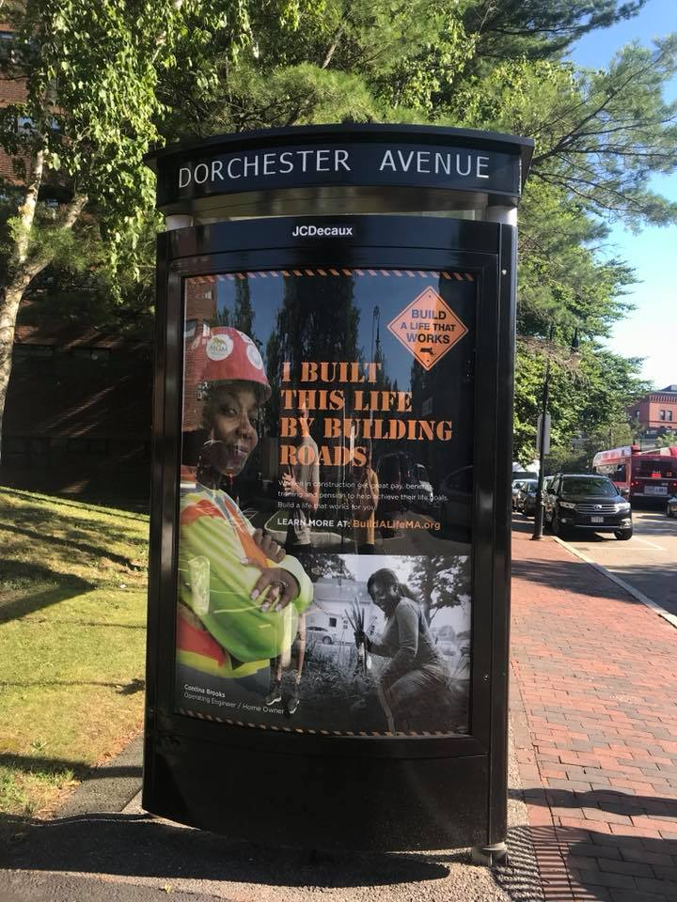
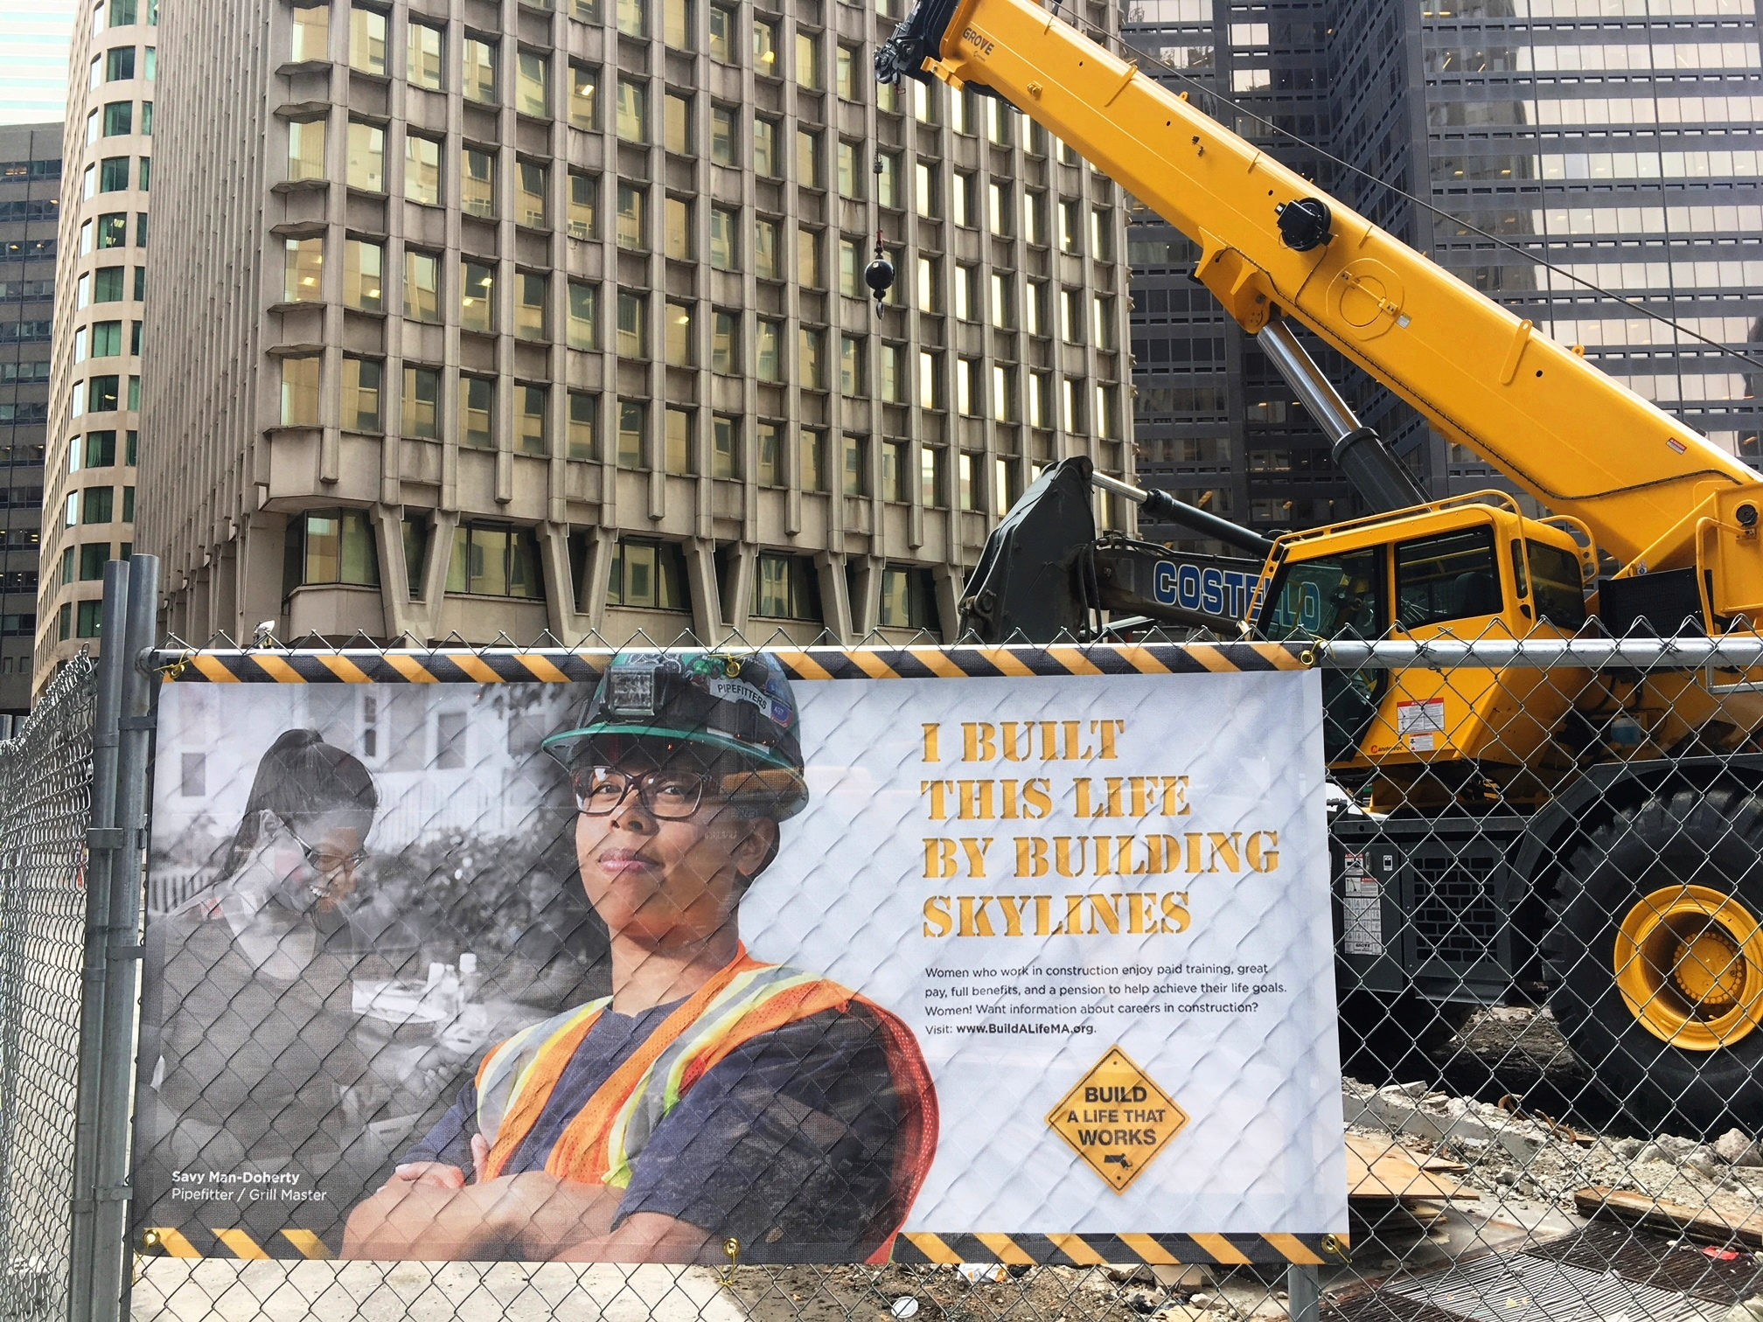
Make Tradeswomen Visible

Slide 16

Notes:
Tradeswomen Tuesday events have resulted in 2600 women career seekers added to our database and over 100 apprentices starting work.

Slide 17
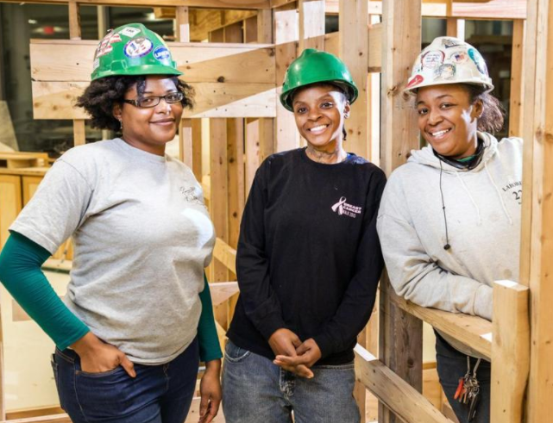
Tradeswomen as Leaders
Speaker’s Bureau
  Active tradeswomen engaged in outreach
  Mentoring & Leadership opportunities
  Inspired formation of Boston Union Trades Sisters
    700+ tradeswomen
    Networking & support
Tradeswomen’s Advisory Committee

Slide 18

Pipeline 3 – MA Girls in Trades
Collaboration of Career Tech Ed High Schools, Unions, Contractors
Encourage young women in Vocational High Schools to pursue careers in the union building trades
  Conference & Career Fair
  Equity in the Trades Student Leadership Councils
  Engagement with guidance counselors and educators

Slide 19
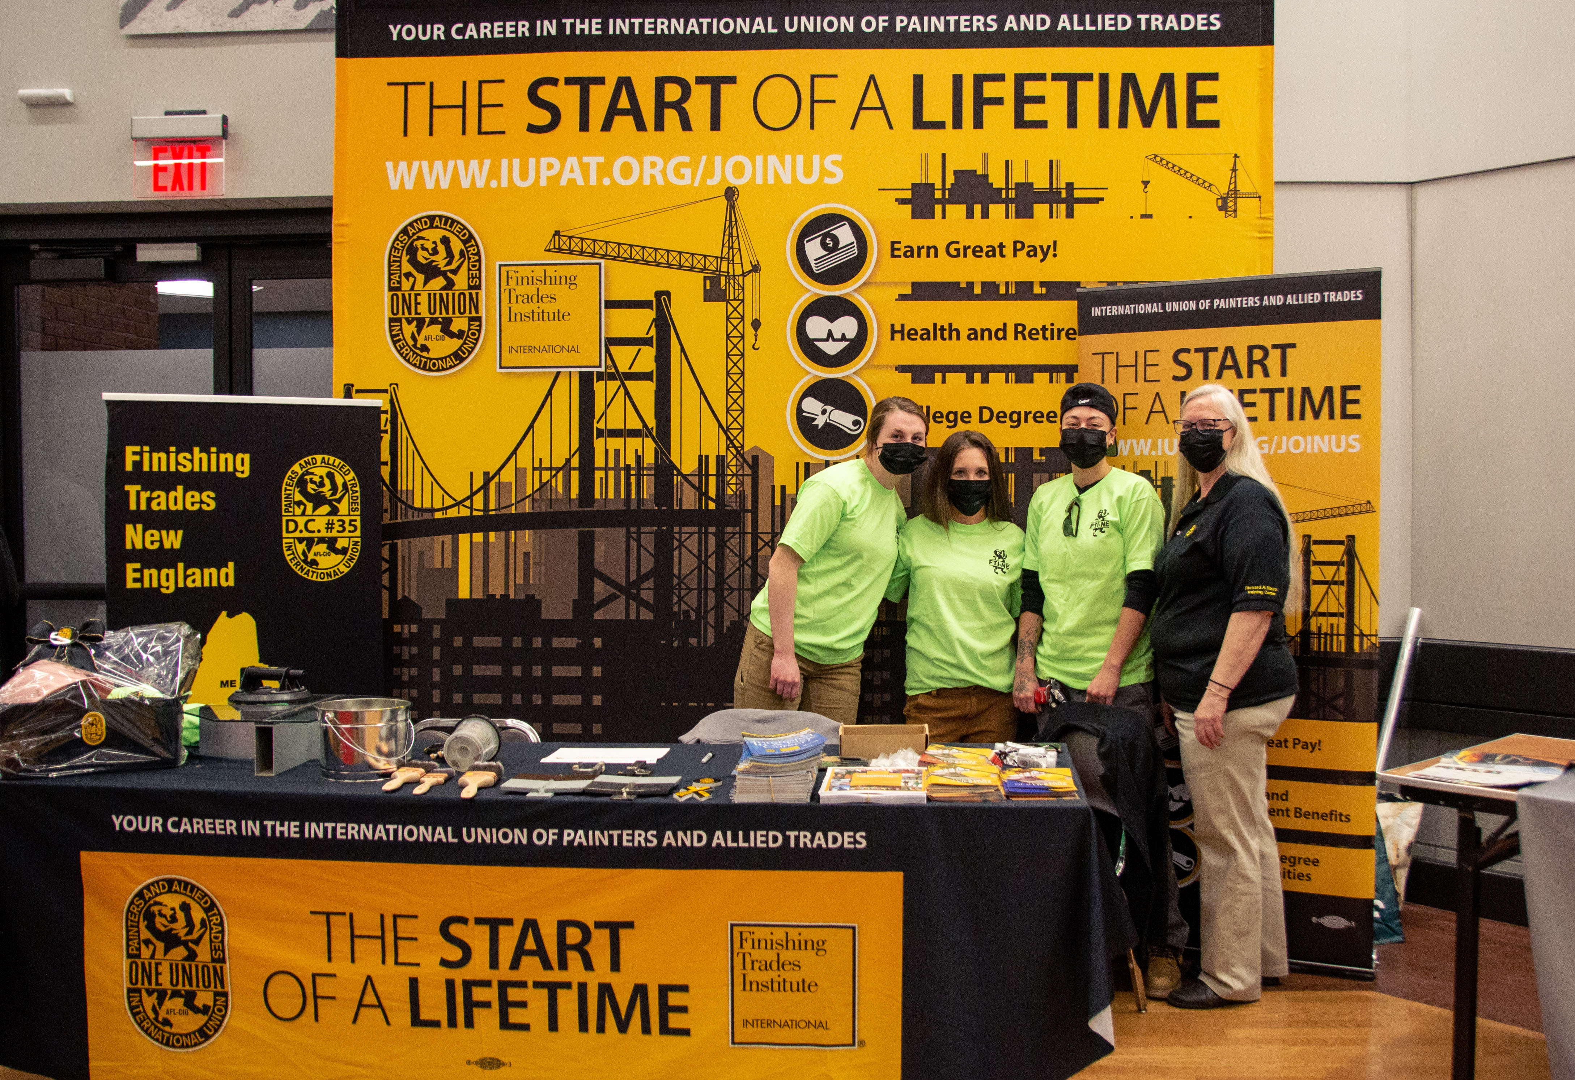
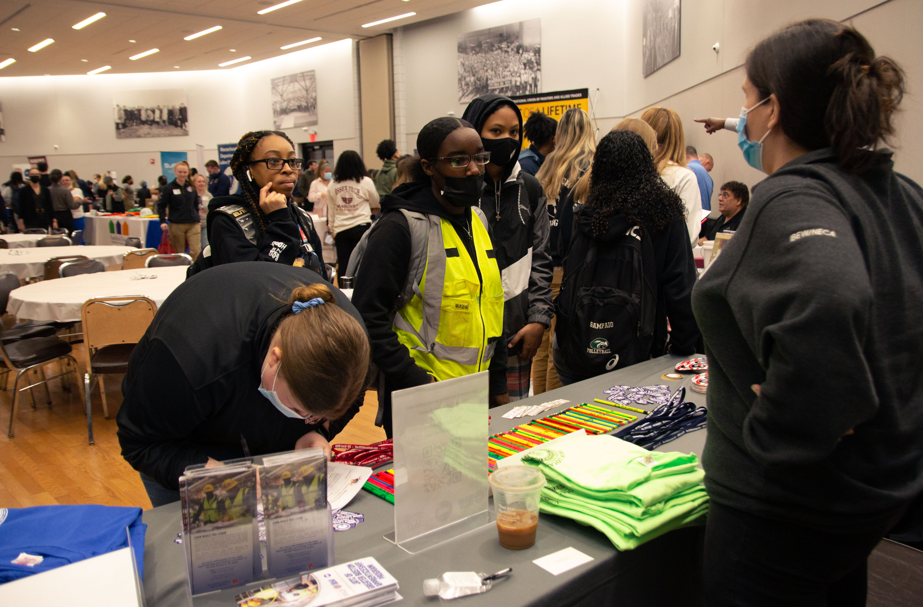
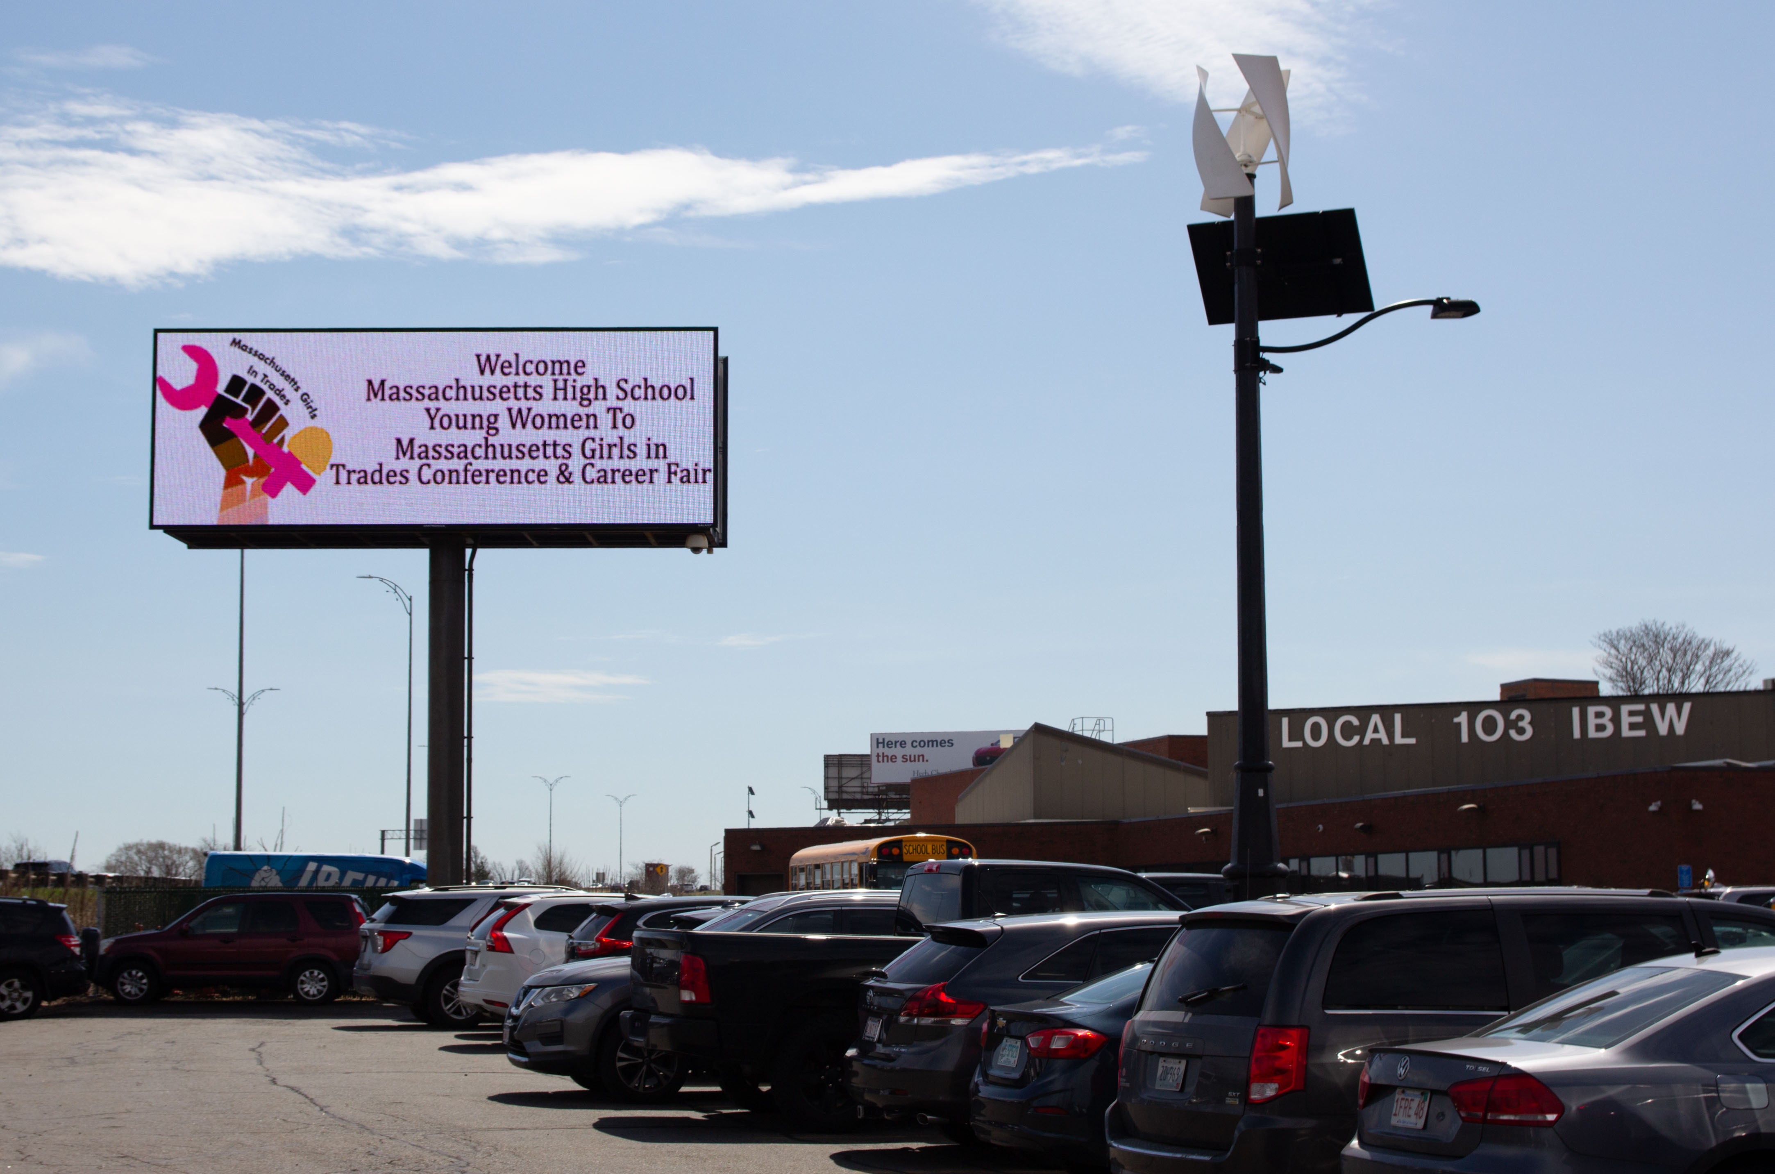

Slide 20
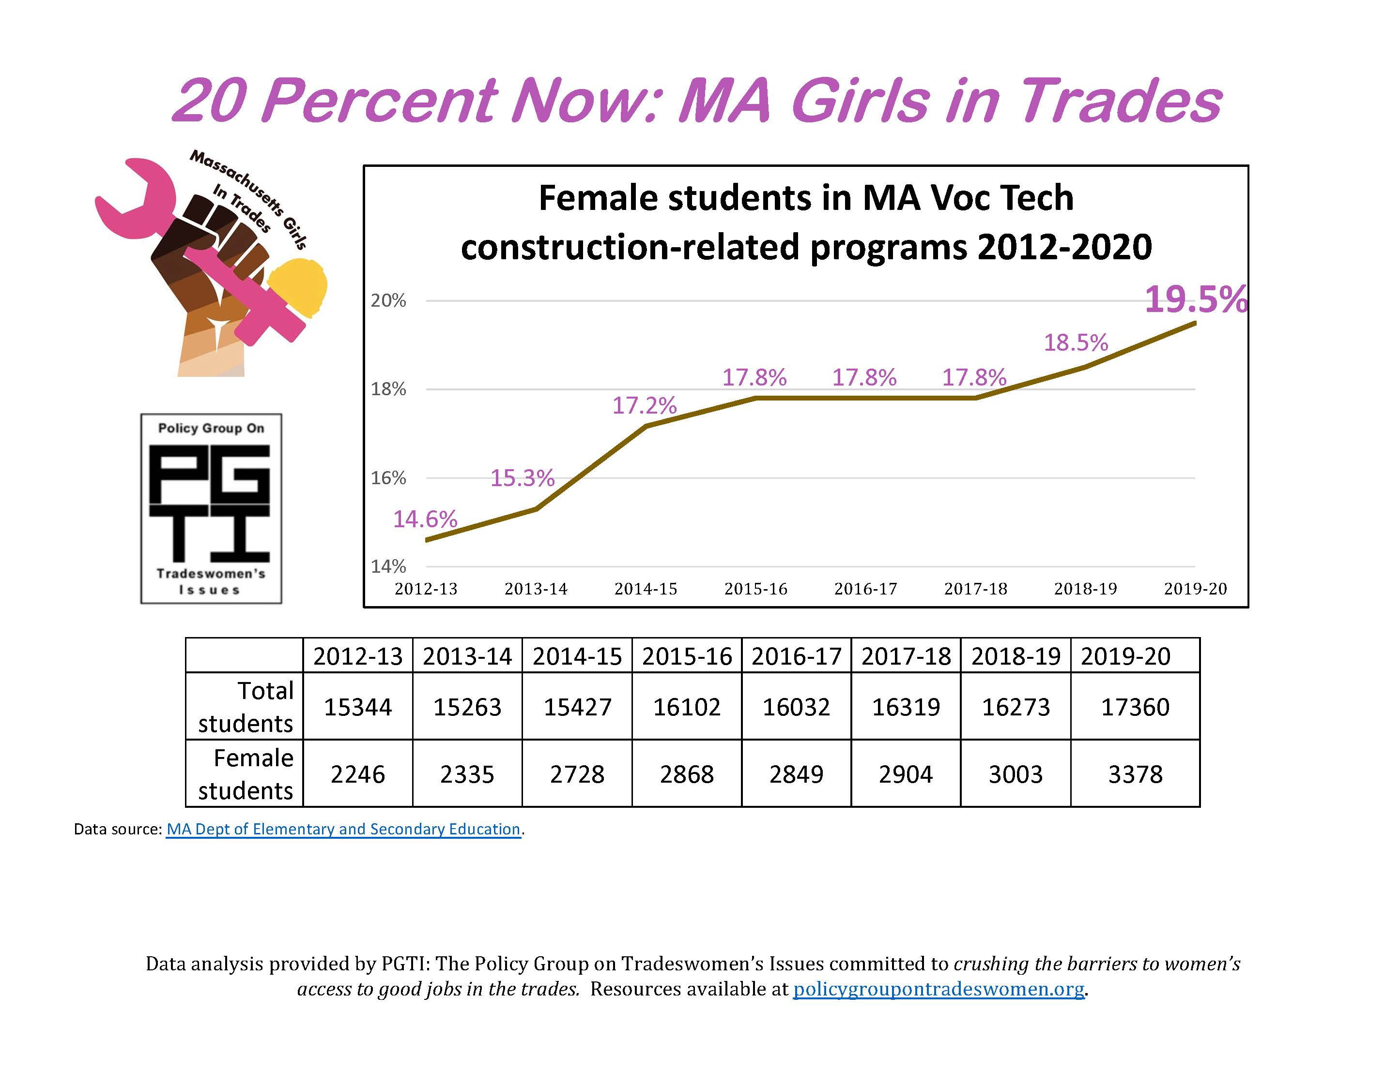

Slide 21
TABLE QUESTION
What pipelines or pathways exist in London, or could be created, for women into the trades?

Slide 22
Contact
Mary Vogel, mary@buildingpathwaysma.org
Amy Courtney, amy@buildingpathwaysma.org

